Slide 1




SMART INDIA HACKATHON 2026
    Problem Statement ID – 26102
    Problem Statement Title- Powered Public Fund Governance & Anomaly Detection Platform For MPLADS/eSAKSHI
    Theme- Smart Automation
    PS Category- Software
    Team ID- 131328
    Team Name - VigourX

Slide 2




IDEA / APPROACH
AI Powered Local Area Development
SATARK
PROBLEM STATEMENT
The existing MPLADS monitoring framework is predominantly post-facto, limiting the timely identification of financial irregularities, duplicate works, cost inflation, contractor concentration, and statutory non-compliance before public funds are committed
What exactly have we built?
SATARK is an AI-powered preventive-vigilance layer that analyses work, financial, vendor, timeline and geospatial data to generate risk scores, explainable alerts and verification priorities.
How is our solution technically different?
SATARK combines rule-based MPLADS compliance, ML/NLP anomaly detection, vendor-pattern analysis and GIS/satellite-based spatial intelligence in one system—moving from simple monitoring to evidence-based risk prediction and prioritisation.
PROPOSED SOLUTION
SATARK can realistically work at government scale
SATARK is designed for scalable, low-disruption deployment. It integrates with existing systems like eSAKSHI, uses authorised data, keeps officials in the decision loop, and enables phased deployment from pilot districts to wider adoption.
FOR BETTER UNDERSTANDING

Slide 3

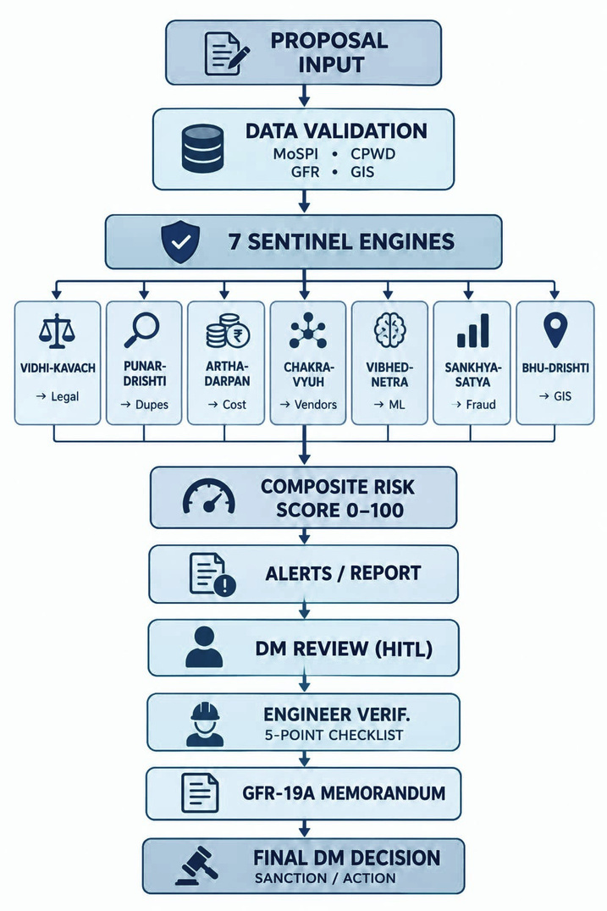

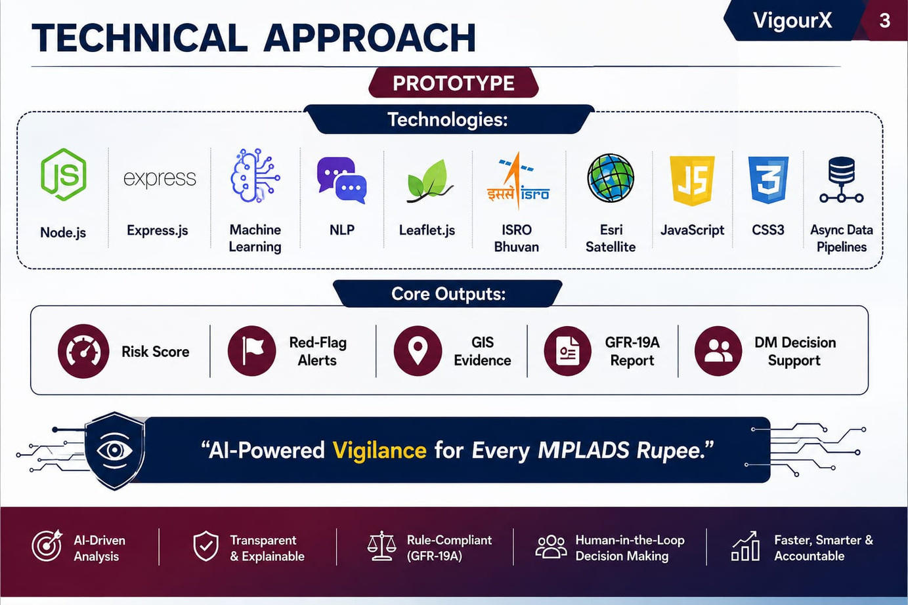

TECHNICAL APPROACH
VigourX
TECHNICAL APPROACH
PROTOTYPE

Slide 4

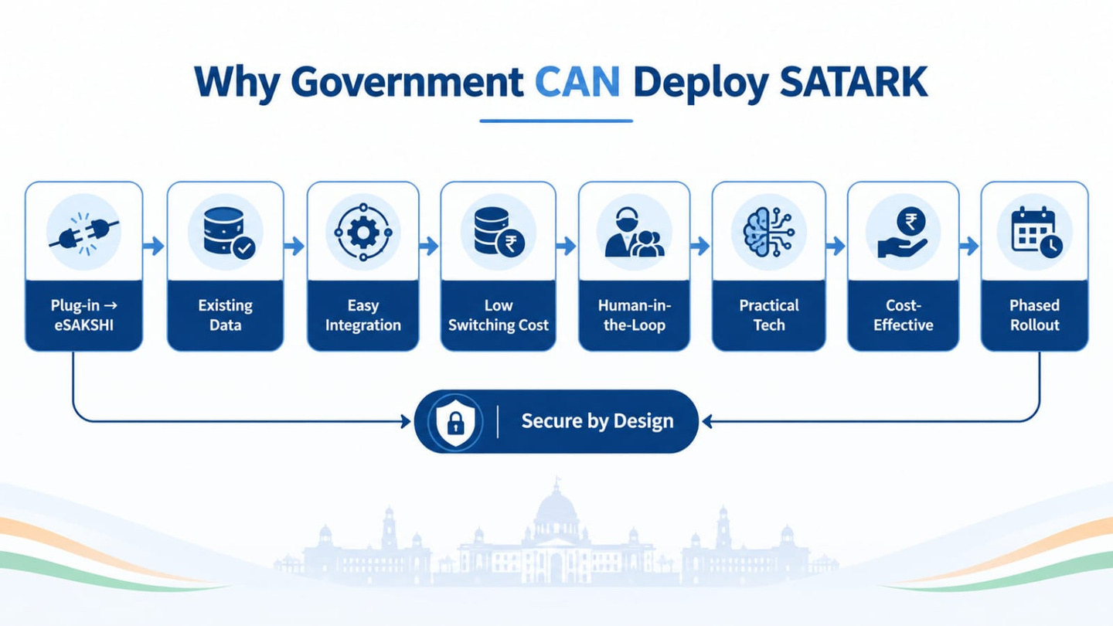
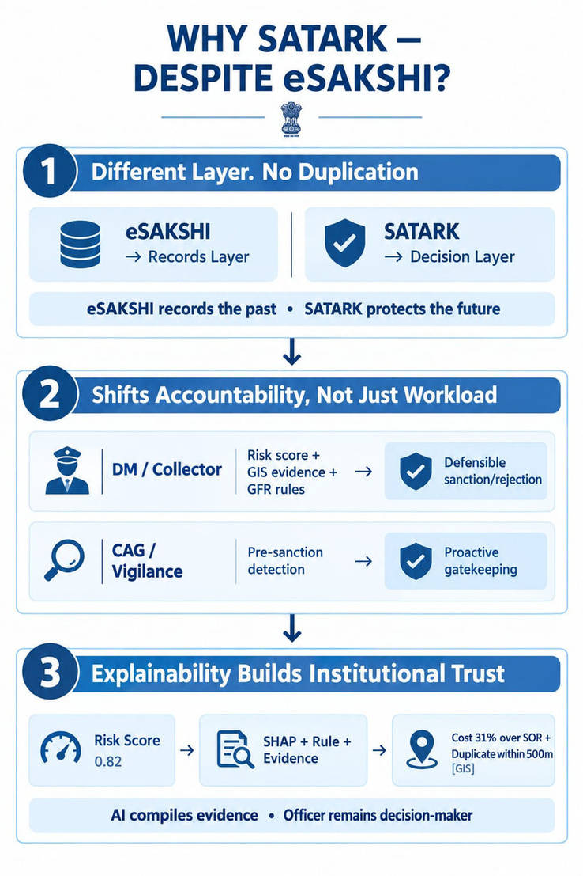
FEASIBILITY AND VIABILITY
VigourX
SATARK - Feasibility
Technologically Viable - Leverages proven AI/ML , NLP and GIS technologies
Data -Driven - Integrates existing eSAKSHI , Treasury , CPWD/DSR and GIS Data
Scalable &Cost-Effective -Supports phased deployment from pilot to nationwide implementation
Human -Governed - AI identifies risk ,officals validate and take final decisions

Slide 5









VigourX
IMPACTS AND BENEFITS
“Smarter Vigilance • Safer Funds • Stronger Governance”

Slide 6

RESEARCH AND REFERENCES
VigourX
Official MPLADS references
MPLADS Official Portal:
https://www.mplads.gov.in/?utm_source=chatgpt.com https://www.mplads.gov.in/mplads/En/2010-mplads-guidelines.aspx?utm_source=chatgpt.com
MPLADS Guidelines:
MPLADS Work Register :
https://mplads.gov.in/mplads/AuthenticatedPages/Reports/Citizen/rptCitizenWorkRegister.aspx
Official eSAKSHI / MPLADS portal
Research Papers — Fraud / Anomaly Detection
1] CAG Performance Audit of MPLADS — fraud/irregularity/audit evidence CAG MPLADS Performance Audit
https://cag.gov.in/en/audit-report/details/2341?utm_source=chatgpt.com
2.] CAG State Audit – MPLADS Irregularities — concrete implementation irregularitiesCAG MPLADS Audit Evidence
https://cag.gov.in/webroot/uploads/download_audit_report/2010/West_Bengal_Civil_2010.pdf

